Slide 1


W2 Partner Network
Prepared for: Moorwand
Copyright 2021. W2 Global Data Solutions Ltd.

Slide 2
LET’S GROW TOGETHER
Copyright 2021. W2 Global Data Solutions Ltd.

Slide 3
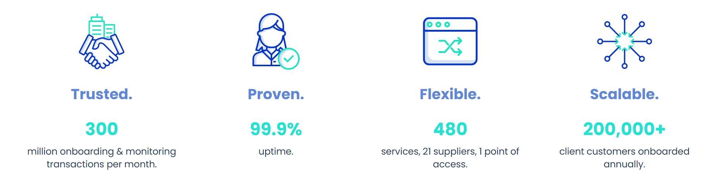
OUR ORGANISATION
W2 makes the complex, simple for you.
Since 2011 W2 has been on a mission to provide the very best regulatory compliance software but making the process as easy as possible. Your business can then focus on what you do best.
ABOUT W2
Complexity should never be a barrier to business and no organisation should suffer due to commercial or technical obstacles.
W2 is committed to delivering proven, innovative and reliable technology that makes it simple to manage and extract value from the KYC and AML supply chain to enable a seamless user experience and improve business.
PARTNER NETWORK
Thank you for inviting us to present our solutions to you. We firmly believe that collaboration is the key driver to business success, and we are so excited to showcase our range of award-winning services to you.
We hope that in doing so, you can understand more about the solutions W2 has to offer and how we can work together to grow both of our businesses.
This presentation outlines our services along with how the partner network works for you. We welcome the opportunity to discuss this with you in more detail.
Copyright 2022. W2 Global Data Solutions Ltd.
Page 3

Slide 4
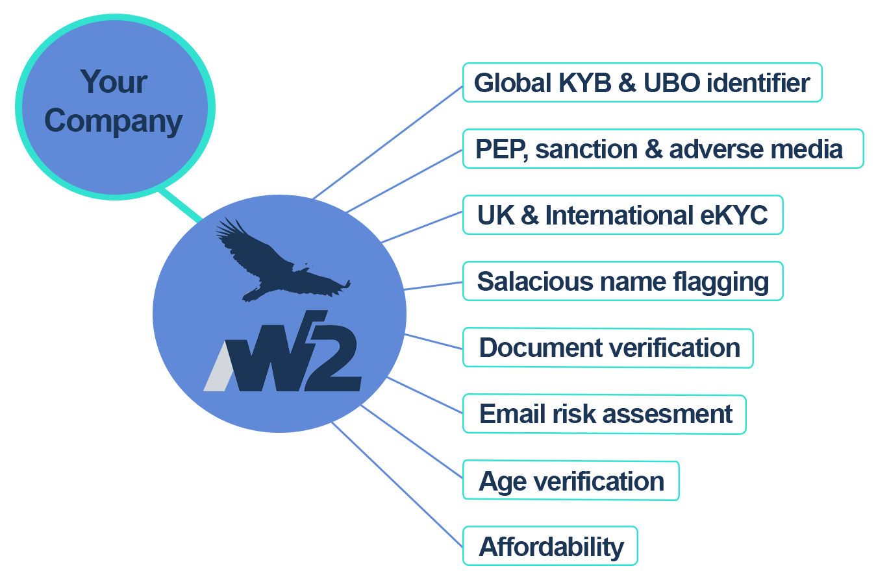
SINGLE PLATFORM
W2 WEB PORTAL
W2’s desktop portal is the gateway to a myriad of databases – users can perform real time searches, receiving instant results for investigation, remediation and case management purposes. All searches completed are accessible for review within a full audit trail.
ONGOING MONITORING
Once your customer is onboarded, the W2 monitoring solution performs routine scheduled screening to ensure that the risk to your business has not increased.
Frequency of screening and matching thresholds can be configured based on your own requirements.
Alerts can be allocated to specific system users. Databases can be segmented into different categories and can be screened against disparate, pre-determined data sources and at different frequencies depending on the risk profiles you apply.
Full online case management tool for reviewing & remeidating alerts.
All the services you need in one place through one API.
Copyright 2022. W2 Global Data Solutions Ltd.
Page 5
Notes:
Remove UBO identifier

Slide 5
SERVICES
W2 provides access to 480 services to 100+ clients tailored to solve compliance issues. These services can be grouped by theme:
Global
eKYC
Data Validation
Access to major credit reference agencies.
ID verification in 160+ countries.
Standardise and populate address automatically to reduce infrastructure burden & improve customer journey.
Cleanse name data to prevent bad data & improve verification flow.
Document Services
Automatic and manual assessment of ID documents globally, including real time facial comparison.
Authentication of utility bills and other proof of address documents.
Fraud Prevention
Assess alternate risk vectors (emails) to increase assurance of ID verification.
Verify the age of customers to ensure compliance with retail regulations.
Global
KYB
Access to global eKYB reports.
Identify the financial risk of your clients.
AML Services
AML assessment of individuals and entities against a variety of global PEP, Sanctions, enforcement and adverse media.
Multiple data providers to match your risk requirements.
Copyright 2022. W2 Global Data Solutions Ltd.
Page 6

Slide 6





































Check Out W2’s Case Studies
OUR CUSTOMER SUCCESS
Payments
Gaming
Foreign exchange/
Currency trading
General
Copyright 2022. W2 Global Data Solutions Ltd.
Page 7

Slide 7
HOW IT WORKS
Copyright 2021. W2 Global Data Solutions Ltd.

Slide 8




THE PROCESS
Enquiry
Enquiry from a potential client asking for KYC, AML, ID Verification, Know Your Business, Fraud Prevention, Anti-Money Laundering.
Referral
Your business refers the prospect to W2 through an email introduction to your designated Partner Executive.
Win
Demos take place, contracts are signed, and the deal is signed with W2.
Commission
You receive your finders fee. Did we forget to mention we can refer business to you as well? *commission paid based on referral agreement being signed.
Copyright 2021. W2 Global Data Solutions Ltd.
Page 8

Slide 9
QUESTIONS?
Copyright 2021. W2 Global Data Solutions Ltd.

Slide 10
#Simplified
#Regulatory
#KnowYourCustomer
#Payments
#Betting
#KnowYourBusiness
#Real-time
#Platform
#Compliance
#Anti-MoneyLaundering
#Seamless
#Proven
#Innovative
#FraudPrevention
#Reliable
#Trusted
Contact:
Name: Lynsey Hoxha
Job Title: Head of Channel Partnerships
Email: lynsey.hoxha@w2globaldata.com
Phone: 0330 088 9542
Web: www.W2globaldata.com
Copyright 2021. W2 Global Data Solutions Ltd.

